Slide 1
Understanding the User 2.2: Surveys & Interviews
By: Minal Bombatkar

Slide 2
PROBLEM STATEMENT
Users need a way to find the yoga expert, specialise in the Pre-natal and post-natal yoga, because they wish to have, it would be easily accessible, more convenient and with verities of experts.
We will know this to be true when we see how many users are using our app to find yoga expert by posting questions, rating to the app and at least 12 download per day.

Slide 3
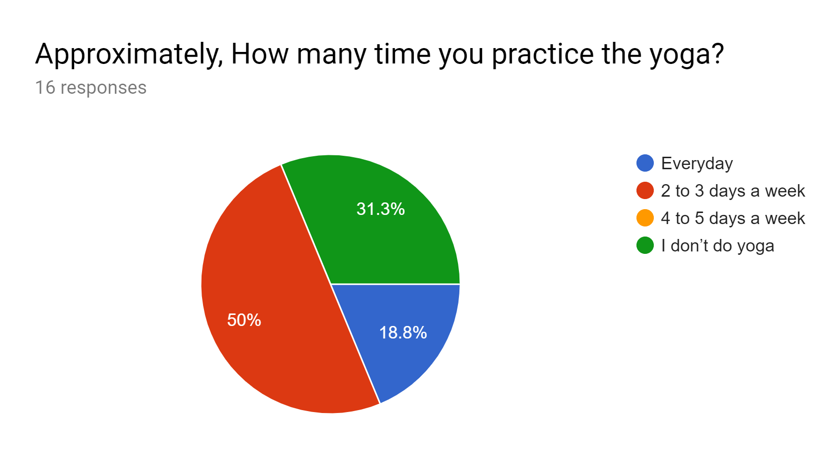
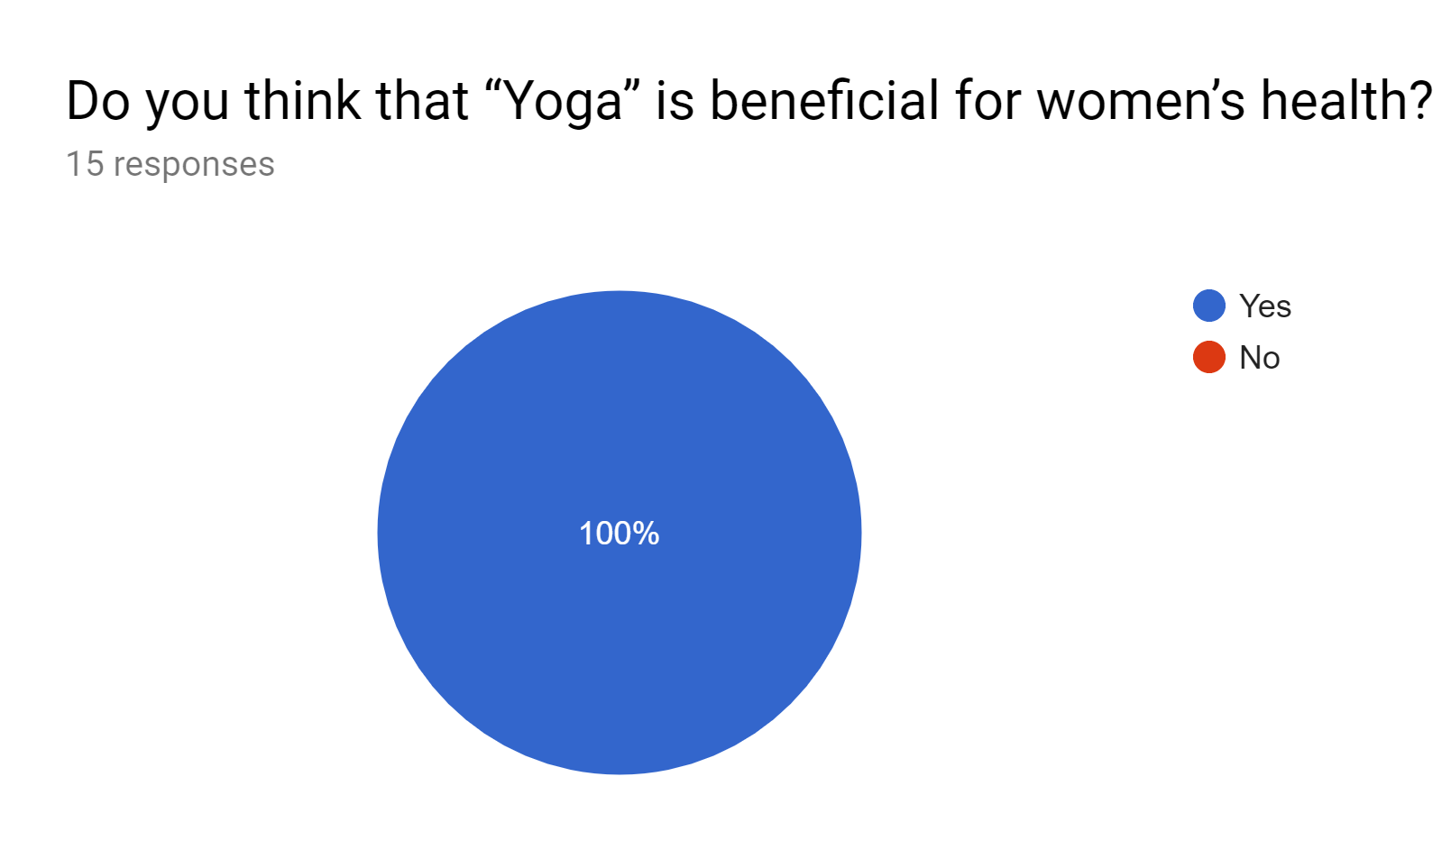
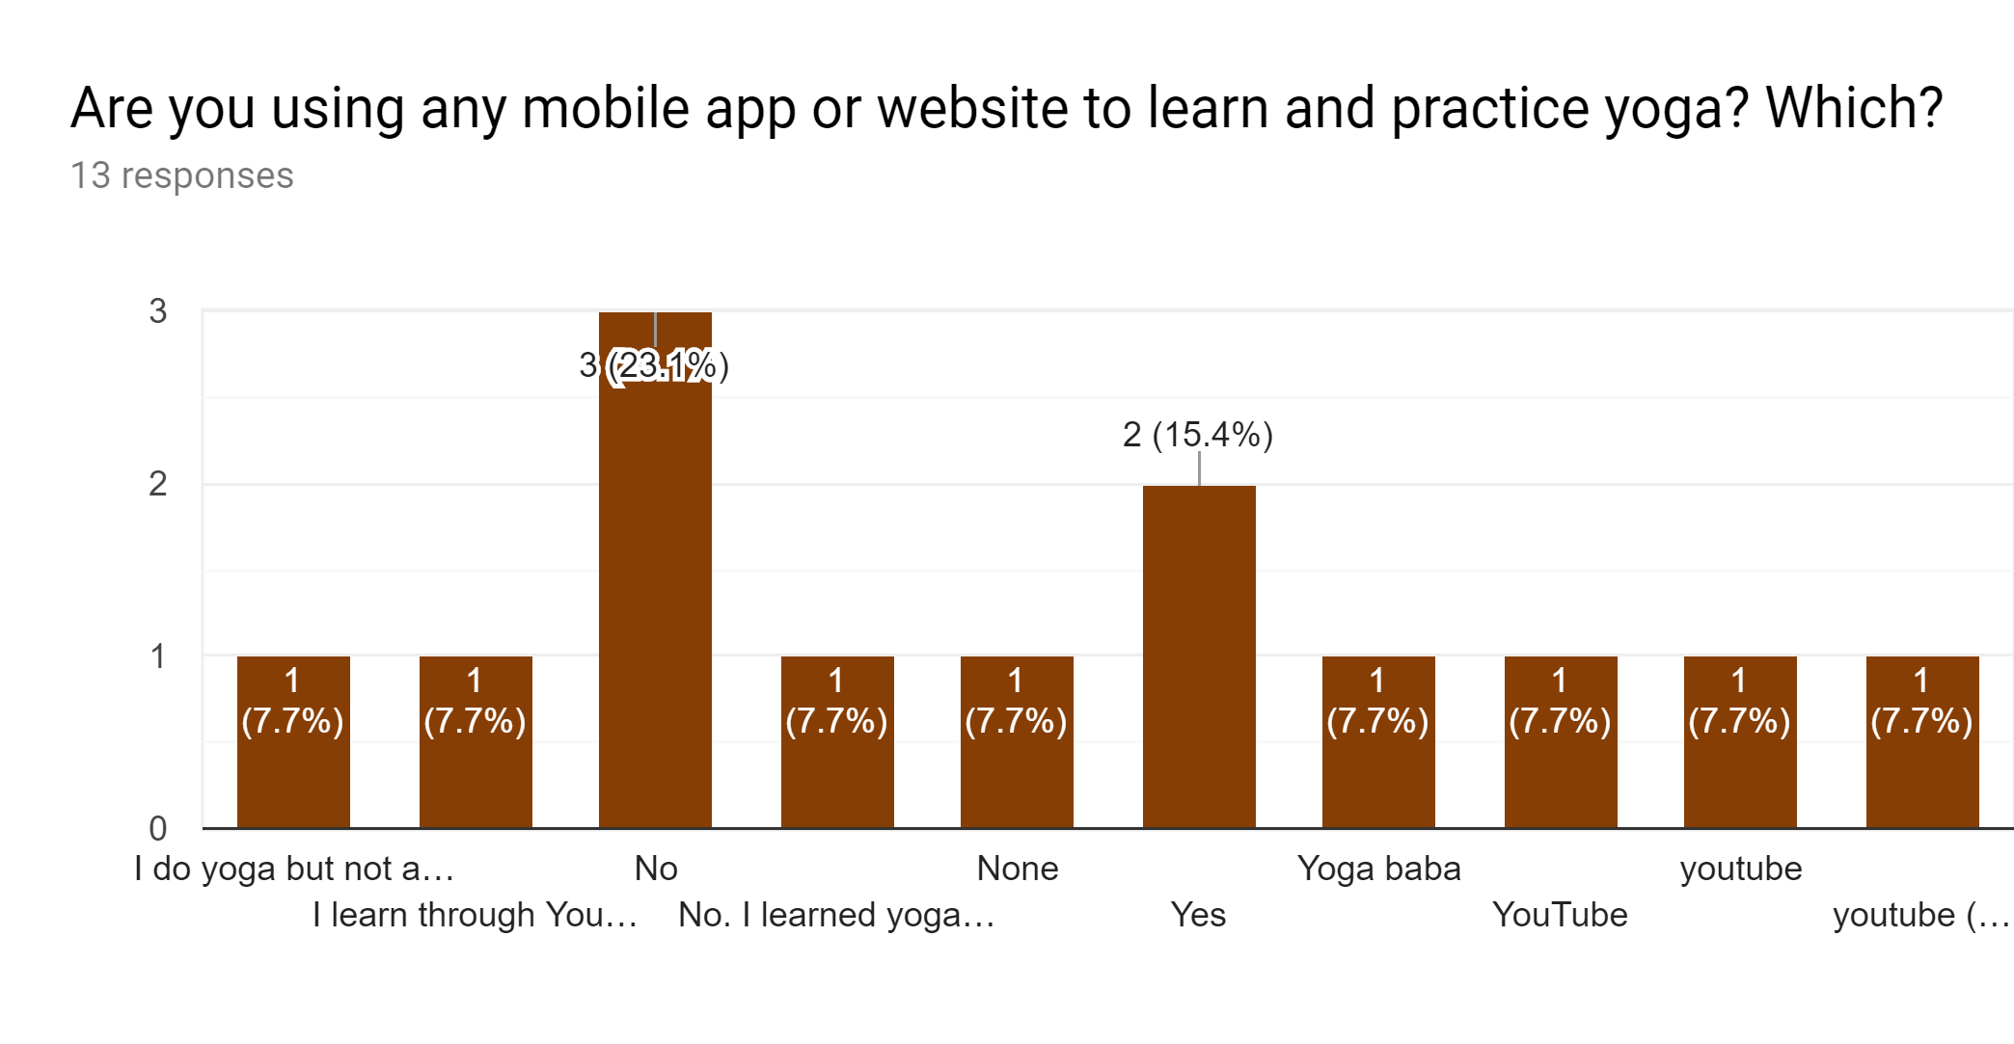
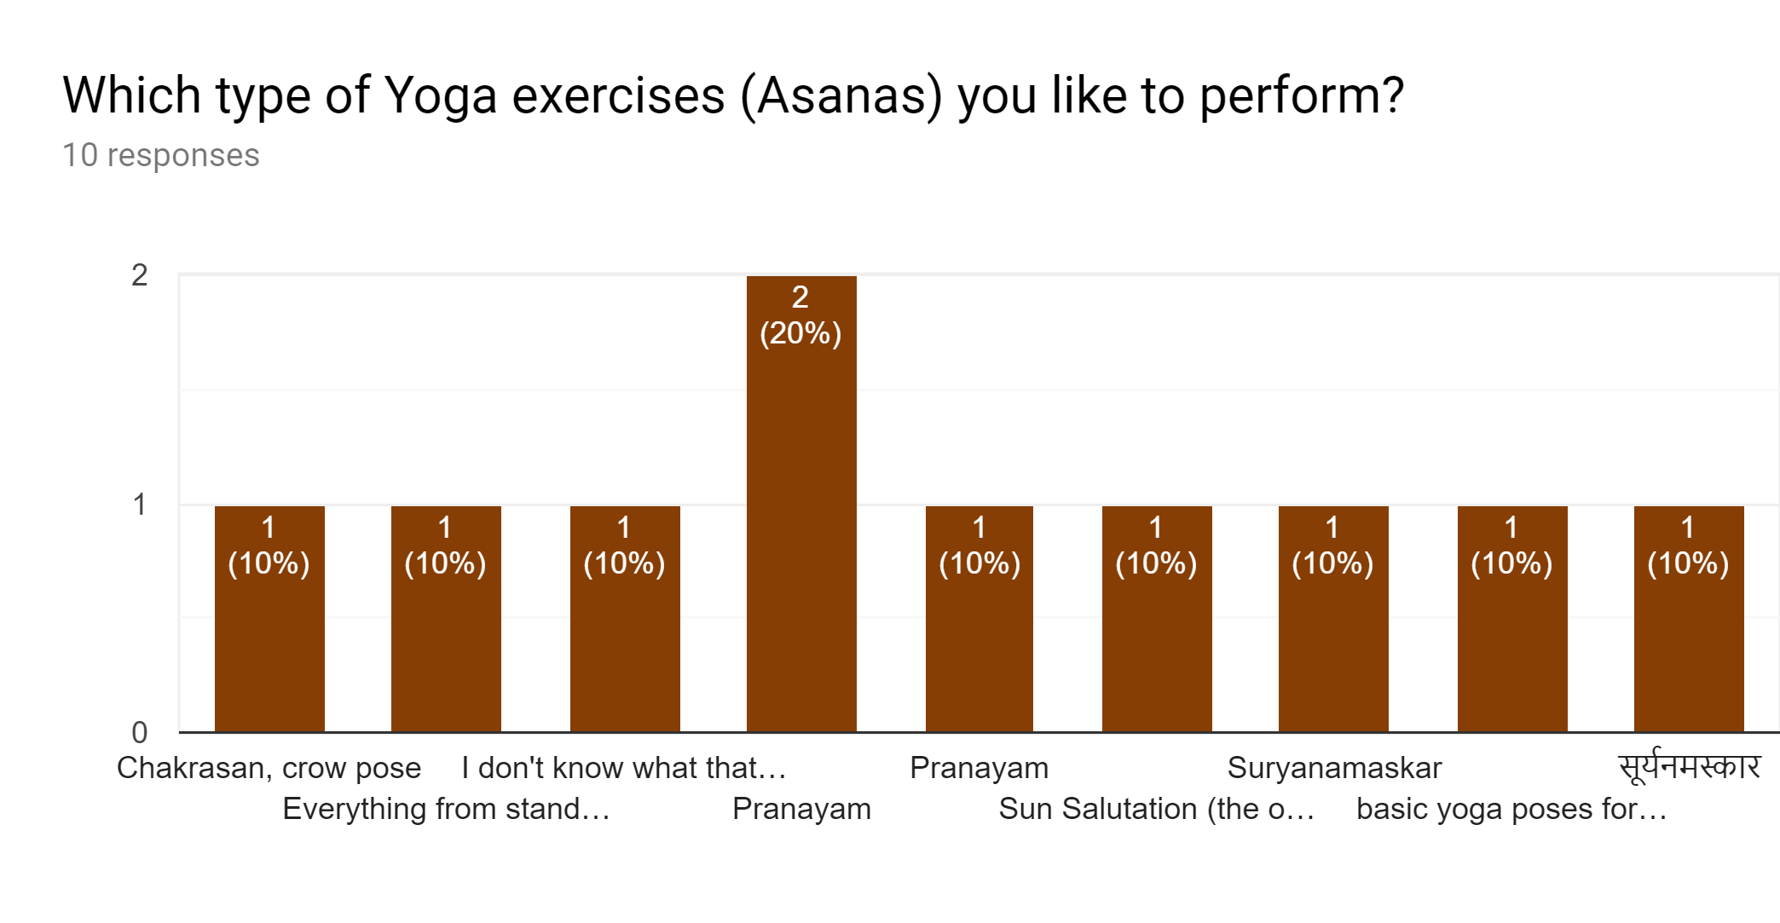
Bonus Task: Survey analysis

Slide 4
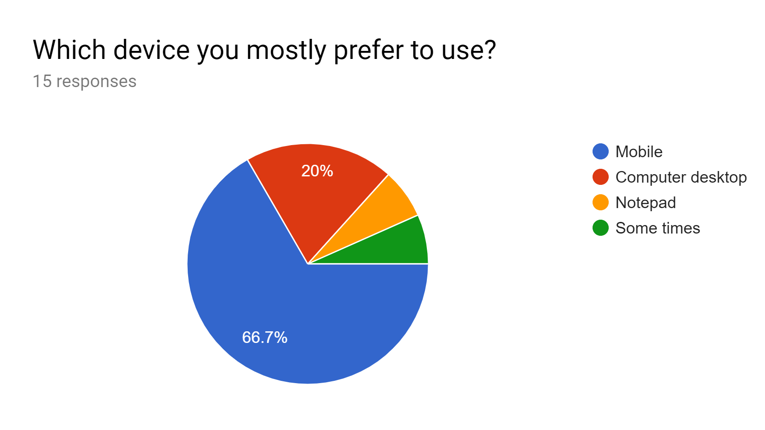
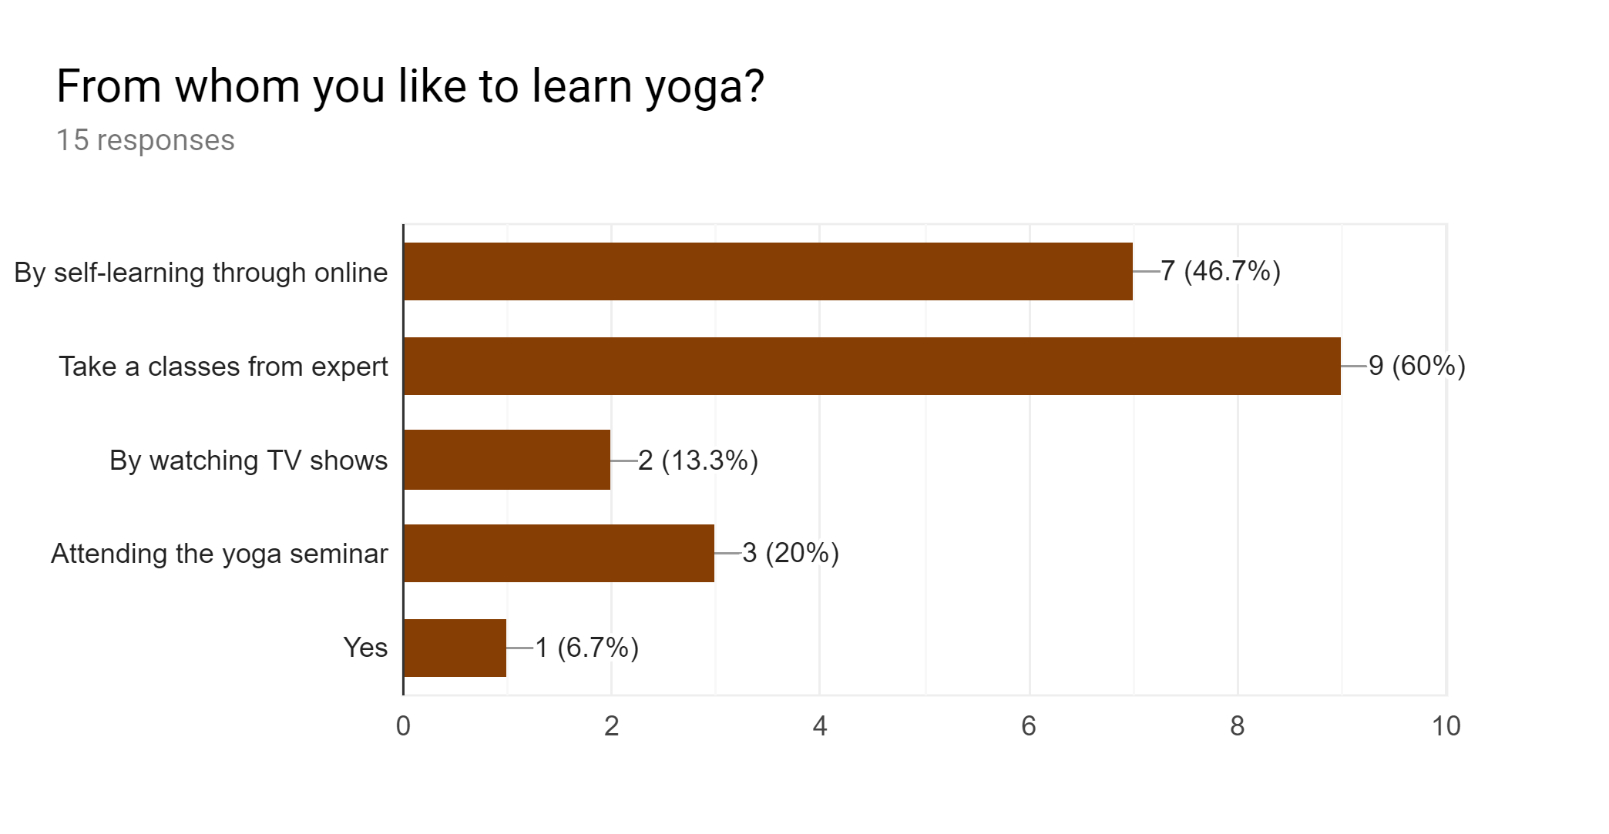
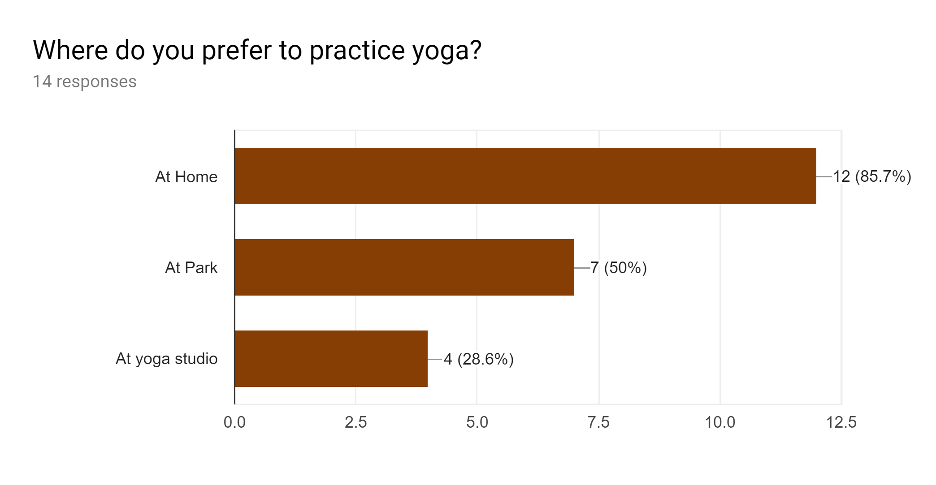
Bonus Task: Survey analysis
From survey analysis identified the following key insights
60% users are learning yoga from Experts
85.7% users like to practice yoga at home
66.7 % users are prefer to use mobile

Slide 5
Research Goals
Understand the user’s preferences according to finding Yoga expert.
Find out the satisfaction and frustration points in user’s experiences.
Collect information on user’s behavioural expectations while contacting yoga experts for consulting.
Try to find out the trust factor and pain point of potential users
Participants
Interview scheduled
The interviewees have been selected according to the following criteria:
Age- 20 to 40
Women's who practice the yoga regularly
All interviews are conducted on telephone
Interviewed duration 20 to 25 min each

Slide 6
INTERVIEW QUESTIONS
1. When did you start doing yoga?
2. Which is the best place to practice yoga? Where you practice it?
3. How often would you practise yoga?
4. How is prenatal yoga different from “regular” yoga?
5. What are the benefits of prenatal yoga?
6. How do you establish the trust on qualified Yoga expert?
7. How do you find a suitable class or yoga teacher?
8. How you use a mobile /website to find a yoga class or yoga teacher?
9. How you schedule an appointment with a yoga teacher?
10. How you make payment to your yoga teacher?

Slide 7
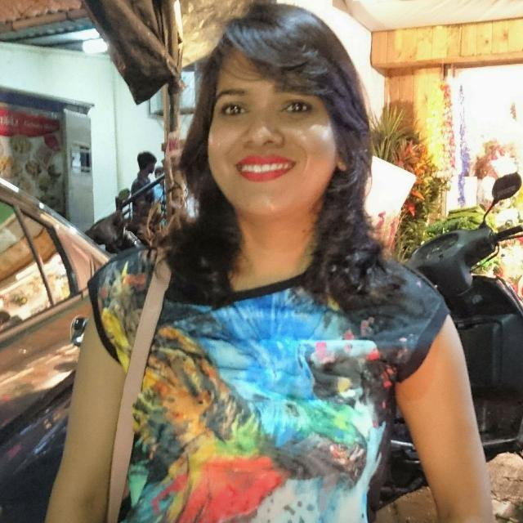
INTERVIEWEE- Nidhi
When did you start doing yoga?
I was in school, we had two weeks seminar conducted by the school free of charge. That time I was doing it for fun and not aware of its benefits and how it is useful for improving concentration.
2. Which is the best place to practice yoga? Where you practice it?
Yoga can be practice at any quite place, It might be the park or Home or at yoga classes.
Mostly I practice at my house balcony or at park.
3. How often would you practise yoga?
I practice it everyday only 30 min yoga help me to provide energy for whole day. As Beautician, I have to be active while working with my clients.
4. How is prenatal yoga different from “regular” yoga?
There are certain postures to be avoided during prenatal yoga. For better consult an experienced teacher before start.
5. What are the benefits of prenatal yoga?
There are so many, but in my case it help me in low back pain and nausea (Morning sickness)
Nidhi
• 33 years old
• Beautician
• Based in Germany
• Languages-Hindi, English
Hobby's- Cooking, Reading
• Regular yoga practiser and did prenatal yoga during her pregnancy

Slide 8
INTERVIEWEE- Nidhi
6. How do you establish the trust on qualified Yoga expert?
Most of time the trust come if your family or friend recommend it. And sometimes use google rating and feedback but actual trust come with your own experience after trying.
How do you find a suitable class or yoga teacher?
Online or ask in friend circle then check out there website or by personal visit to the class. If the class schedule match with my Scheduled then I will move forward.
8. How you use a mobile /website to find a yoga class or yoga teacher?
I prefer to use mobile because it is so handy and always with me. I prefer to check rating and feedback, years of experience has the yoga teacher, how far or near is the location.
9. How you schedule an appointment with a yoga teacher?
For taking an appointment, I have to check the available time and date of yoga teacher with my schedule. If it match then I will book appointment by phone or personal visit.
10. How you make payment to your yoga teacher?
By using Debit card, prefer to pay fees in monthly installments.

Slide 9
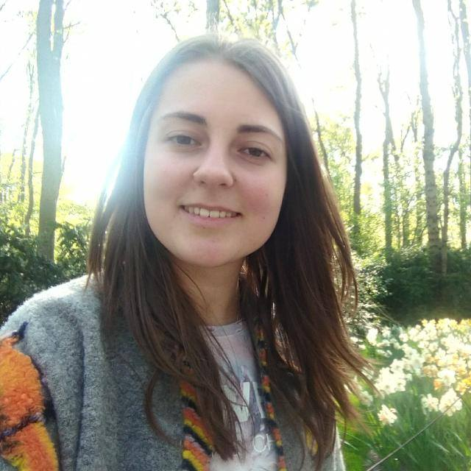
INTERVIEWEE- Emma
When did you start doing yoga?
Two years before, when I had problem in my back. After learning yoga from expert, I realised that your bodies were not designed to spend hours at a time hunched over computers. The meditation aspects of yoga provide with the opportunity to find stillness and peace, which is essential for mental well being, but hard to find in this digital age.
2. Which is the best place to practice yoga? Where you practice it?
Mostly I practice at yoga studio, when not possible to go to studio, I do it at my home by watching online video.
3. How often would you practise yoga?
I practice it 2 to 3 days a week, I want to do it more but I have to manage my job as well as yoga studio timing sometime it is difficult or impossible.
4. How is prenatal yoga different from “regular” yoga?
I have no personal experience about prenatal yoga, In future, for sure I will continue my yoga practice during my pregnancy as well. As I studied that some stretching exercises should be avoided during pregnancy.
5. What are the benefits of (prenatal) yoga?
It will help to Reduce stress and anxiety during pregnancy.
Emma
• 28 years old
• Software Engineer
• Based in Germany
• Languages- German, English
Hobby’s- Fitness, Travelling
• Studies yoga online and offline from yoga teacher

Slide 10
INTERVIEWEE- Emma
6. How do you establish the trust on qualified Yoga expert?
Trust always come from own experience even through very good feedback or rating not able to count it. Recommendation help a bit.
7. How do you find a suitable class or yoga teacher?
Through Online search, Mobile apps, YouTube
8. How you use a mobile /website to find a yoga class or yoga teacher?
I search online, short list and then finalised with the considering its features such as Fees of class, Duration per week (Time factor), location, experience of yoga teacher
9. How you schedule an appointment with a yoga teacher?
If online portal is available to book appointment then I prefer to use it.
10. How you make payment to your yoga teacher?
If there is sale (Discount) or some offer on fees of yoga class then I like to grab it. Normally I pay by online mode.

Slide 11

INTERVIEWEE- Tejushree
When did you start doing yoga?
I came to know about Yoga, when I was first time pregnant and my doctor recommended to do to deal with hormonal, physiological and anatomical changes that happens during pregnancy. Then I never left yoga
2. Which is the best place to practice yoga? Where you practice it?
I personally like to do it at home with my own comfort but for prenatal yoga lesson,
I have to go to Yoga classes to do it and learn from yoga teachers, they are expert in prenatal and post natal yoga.
3. How often would you practise yoga?
2 to 3 days a week.
4. How is prenatal yoga different from “regular” yoga?
There are different yoga asanas for each trimester. It would be practice during their 41st and even 42nd week of pregnancy.
What are the benefits of prenatal yoga?
Improve sleep, Reduce stress, Increase strength, flexibility. Help to decrease some common side effects that accurse during pregnancy.
Tejushree
• 36 years old
• Home maker with 1 kids and expecting her second baby soon
• Based in India
• Languages- Marathi, Hindi
Hobby's- Shopping, Yoga
• Regularly taking prenatal yoga lessons from very known yoga expert

Slide 12
INTERVIEWEE- Tejushree
6. How do you establish the trust on qualified Yoga expert?
Doctor recommendation come first. If my doctor recommended that then I prefer to try it first.
7. How do you find a suitable class or yoga teacher?
Advertisement in news paper or through online search
8. How you use a mobile /website to find a yoga class or yoga teacher?
I use mobile for searching any thing.
9. How you schedule an appointment with a yoga teacher?
With mobile phone call I make appointment with my Yoga teacher.
10. How you make payment to your yoga teacher?
I am playing per lessen (Per visit) to my prenatal yoga teacher. It might be by cash or debit card.

Slide 13
Overall Summary
By combining the Survey result and User interviews, I came to know this points:
Users like to learn yoga from Experts, It might be prenatal, postnatal or regular yoga.
Users like to preferred doing yoga at Home rather then going to studio or classes. I found this is a pain point of user with this current system.
To get trust, users are open to experience with new yoga experts. As of now, they consider the recommendations from Doctors, friends and family or use google feedback and reviews.
Up to 100% of users are agreed that Yoga is beneficial for women’s health and it helps to improve the condition during pregnancy.
From the above date, It is clear that users need a way to find the yoga expert because they wish to learn from experts and it would be easily accessible in more convenient way.

